Slide 1
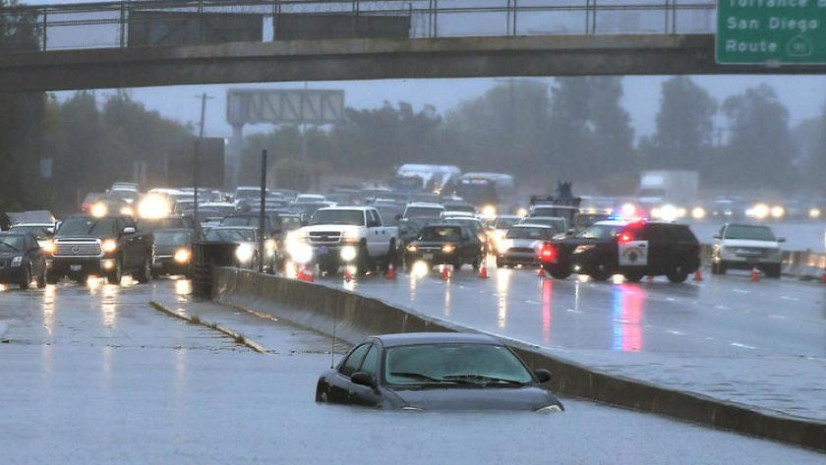
Predicting Road Accidents with Climate Data

Slide 2
PROBLEM
The population can’t grasp how Climate Change will affect their everyday lives
Without this understanding people are not motivated to make changes in how they behave

Slide 3
SOLUTION
Show how climate change will affect something they interact with every day: road conditions
Provided: ClimateData.ca contains historical and future climate projections from multiple models
Issue: Where can I get road condition data?

Slide 4

MONTREAL OPEN DATA PORTAL
Montreal Open Data Portal contains historical data on vehicle incidents from 2012-2017
This data contains information in individual vehicle collisions with a variety of statistics on the crash

Slide 5
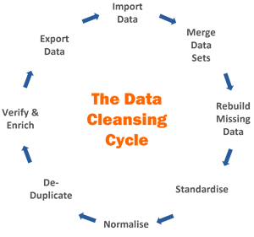
METHOD
Download precipitation data for 12 grids encompassing Montreal
Download vehicular incident data & assign each incident to a grid
Merge the 2 datasets & group by grid & date

Slide 6
THE DATA
26,304 rows representing vehicle collisions for a day in a given grid with the associated historical precipitation prediction
Information Containing (per day and per grid):
Information on collisions (# of incidents, # vehicles involved, # people killed etc…)
Total precipitation
Day of week & month (One-Hot Encoded)

Slide 7
THE DATA
Statistics | Values
Number of Rows | 26, 304
Training (%) | 67
Number of Targets for Regression | 13
Training Dataset size used (MB) | 9.0
Number of Features Generated | 44

Slide 8
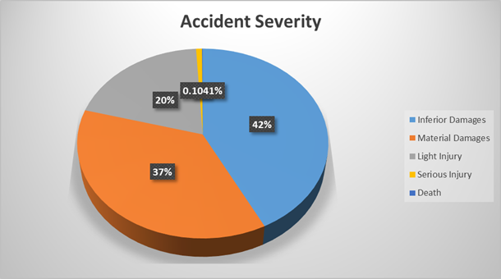
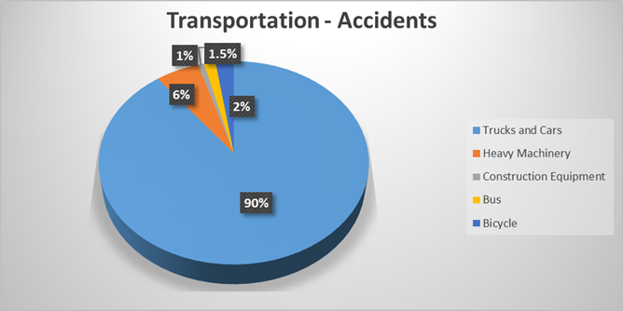
THE DATA

Slide 9
STATISTICAL LEARNING
Linear Regression was used as baseline
Random Forrest & GBM was attempted
Hyperparameters were tuned via Gridsearch
Random Forrest performed best across the board

Slide 10
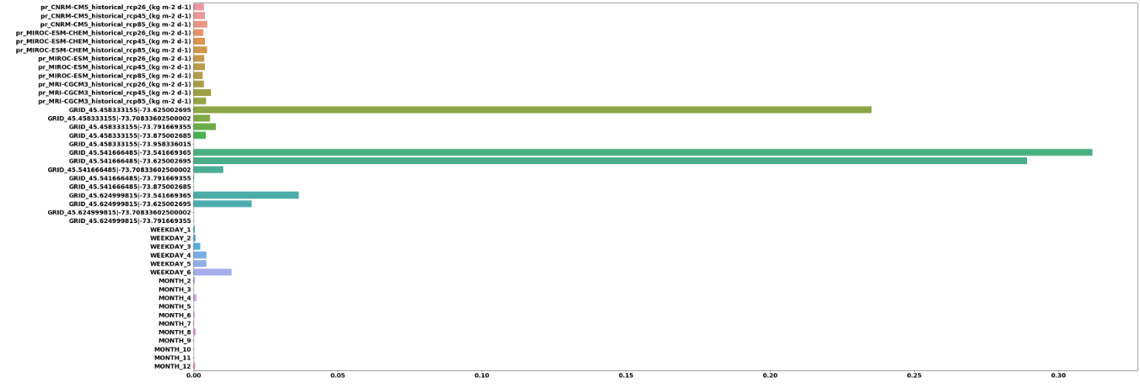
FEATURE IMPORTANCE
Feature Importance extracted from Random Forrest on predicting # of incidents:
Precipitation Data
Location Data
Time Data

Slide 11
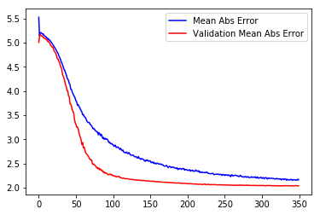
NEURAL NETWORK
DNN performed only marginally better than the statistical classifiers for predicting # of incidents (MAE=2.02)
_________________________________________________________________
Layer (type) Output Shape Param #
=================================================================
dense_1 (Dense) (None, 200) 8800
_________________________________________________________________
dropout_1 (Dropout) (None, 200) 0
_________________________________________________________________
dense_2 (Dense) (None, 250) 50250
_________________________________________________________________
dropout_2 (Dropout) (None, 250) 0
_________________________________________________________________
dense_3 (Dense) (None, 1) 251
=================================================================
Total params: 59,301
Trainable params: 59,301
Non-trainable params: 0

Slide 12
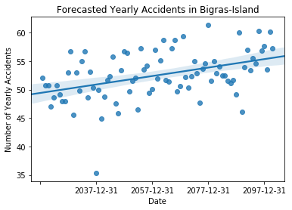
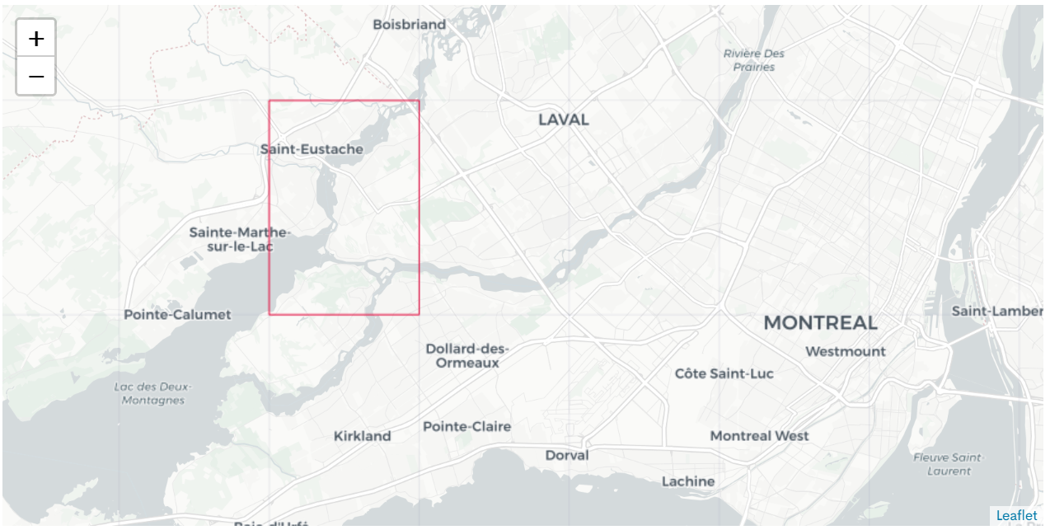
FORECASTING: BIGRAS-ISLAND, MONTREAL, QC
In Bigras-Island – Vehicular incidents are expected to rise by 13%

Slide 13
CHALLENGES
Interpretation of our features from climatedata.ca – Difficult User-Friendly interpretation.
Computational Expensive Regressor Models – Gradient Boosting, Forests, and DNN
Merging two datasets of entirely different formats

Slide 14
NEXT STEPS
Continue tuning these algorithms
Expand the number of grids considered to other locations (all of Canada?)
Investigate CNNs on the grids
Construct a report alerting the public of the dangers of Climate Change and how it will affect driving conditions

Slide 15
THANKS!
Any questions?
Contact us:
Oliver Foster
Michael Pucci

